Slide 1
Oil Spill Response in Ice
CGPRT(W) : Ensuring Clean Seas and Coasts in Western Region ……

Slide 2
Objective
To understand the unique aspects of oil spill response in ice
Considerations for response activities in ice
Review response strategies for responding to oil in ice including limitations
CGPRT(W) : Ensuring Clean Seas and Coasts in Western Region ……

Slide 3
Considerations for Oil in Ice
Safety
Environment
Ice conditions
Location of oil in ice
Oil behaviour in ice
Effectiveness of response equipment in ice
Logistics for remote areas is a major factor
CGPRT(W) : Ensuring Clean Seas and Coasts in Western Region ……

Slide 4
Safety
Safety of personnel is always the first priority in spill response
Response operations in ice present unique challenges with respect to safety
CGPRT(W) : Ensuring Clean Seas and Coasts in Western Region ……

Slide 5
Safety
  Cold related injuries due to exposure e.g. hypothermia, frost bite
  Falling into icy water
  Slippery surfaces
  Operating vessels in ice infested waters
  Bearing capacity of ice
  Ice movement of broken ice (currents and wind)
CGPRT(W) : Ensuring Clean Seas and Coasts in Western Region ……

Slide 6
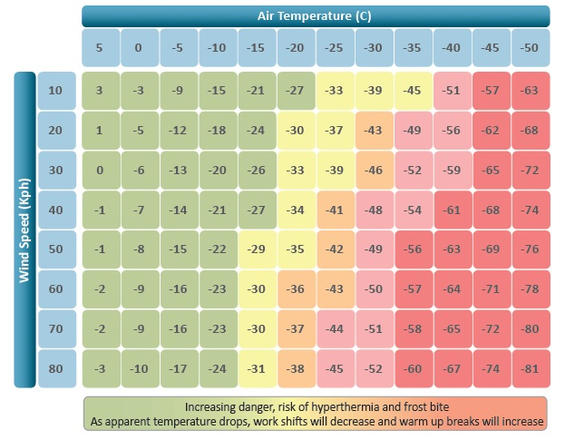
Safety
Source: OSRL
CGPRT(W) : Ensuring Clean Seas and Coasts in Western Region ……

Slide 7
Environment
Potential environments for oil in ice:
Marine
Coastal
Lakes
Rivers
CGPRT(W) : Ensuring Clean Seas and Coasts in Western Region ……

Slide 8
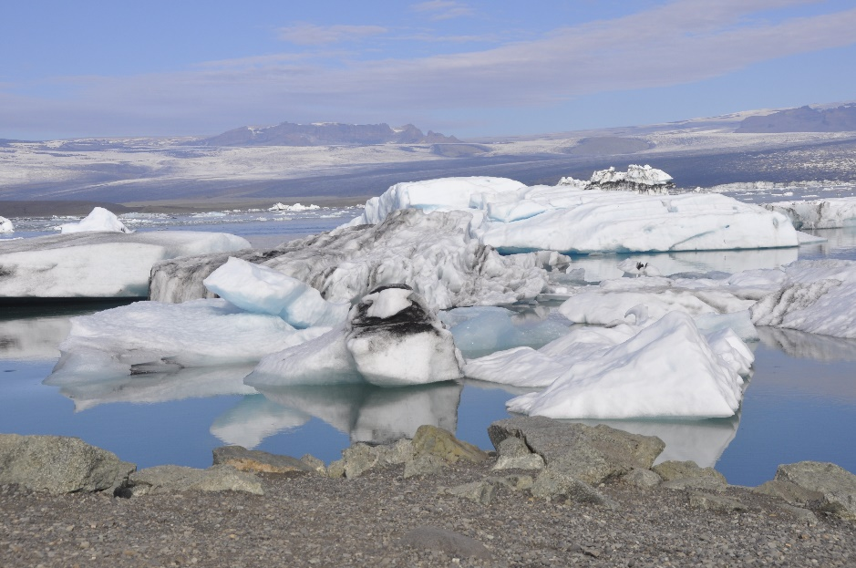
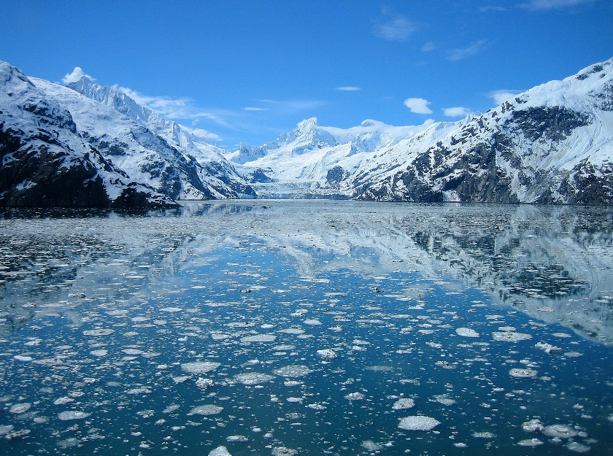
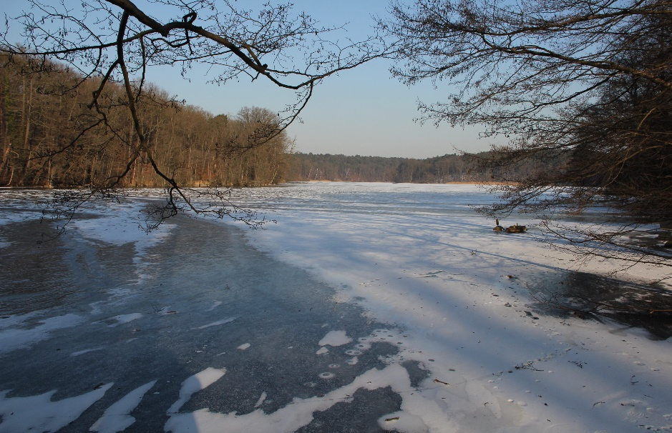
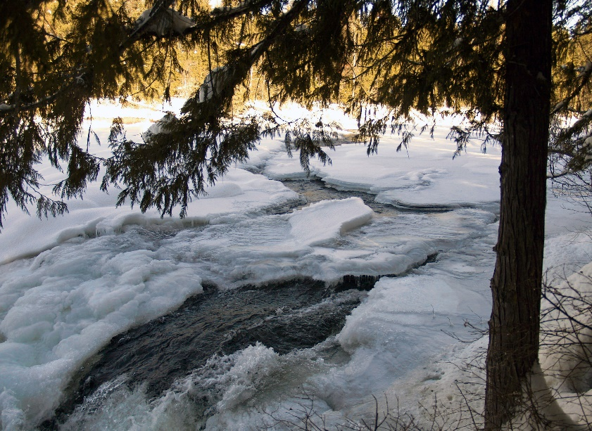
Environment
Source: OSRL
Source: OSRL
Source: OSRL
Source: OSRL
CGPRT(W) : Ensuring Clean Seas and Coasts in Western Region ……

Slide 9
Ice Conditions
Solid ice – waters are completely covered in ice, no movement
Broken ice – waters are partially covered in ice and therefore can move with wind and currents – concentration of ice expressed as a percentage
Ice along shorelines – solid ice attached to shoreline, broken ice accumulating along a shoreline and stranded, broken ice floating against the shoreline
CGPRT(W) : Ensuring Clean Seas and Coasts in Western Region ……

Slide 10
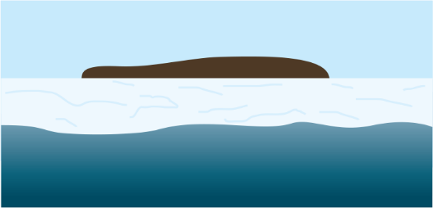
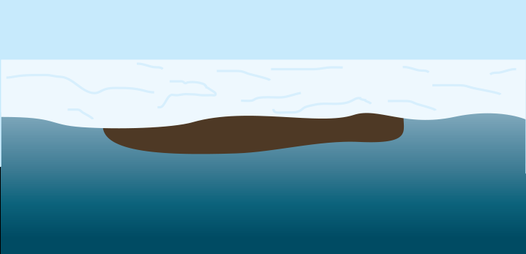
Oil in Ice Locations
Solid ice
  oil on top of ice, with or without snow cover
  oil submerged below ice
Source: OSRL
Source: OSRL
CGPRT(W) : Ensuring Clean Seas and Coasts in Western Region ……

Slide 11

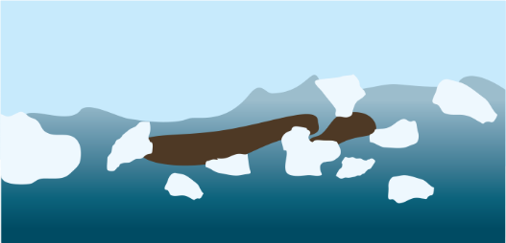
Oil in Ice Locations
Broken ice
  oil on surface of water mixed with broken ice, with or without snow cover
  oil submerged below broken ice
Source: OSRL
Source: OSRL
CGPRT(W) : Ensuring Clean Seas and Coasts in Western Region ……

Slide 12
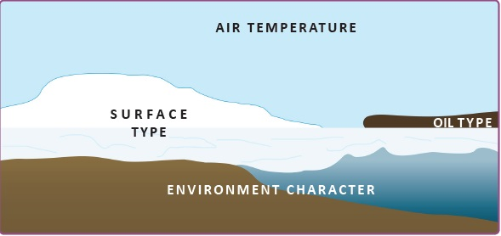
Oil in Ice Locations
Ice along shorelines
  Oil can be held away from shoreline by ice acting as a barrier
  Oil can be mixed with broken ice on the shoreline
  Oil can be under the ice along the shoreline
Source: OSRL
CGPRT(W) : Ensuring Clean Seas and Coasts in Western Region ……

Slide 13
Oil Behaviour in Ice
Weathering of oil will occur more slowly in cold temperatures
  Safety consideration as light ends will persist longer
  Alters the window of opportunity for burning and dispersants
Cold temperatures may affect the ability to skim/pump oil due to pour point and viscosity
CGPRT(W) : Ensuring Clean Seas and Coasts in Western Region ……

Slide 14
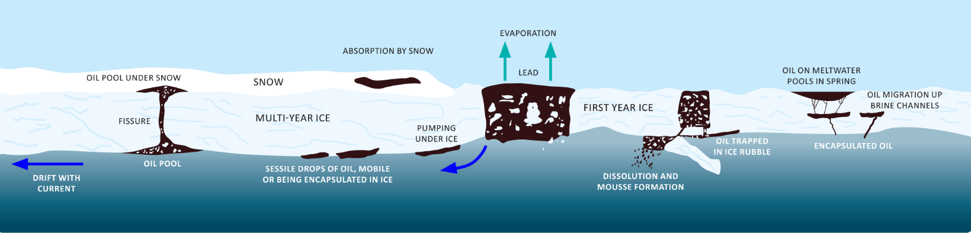
Oil Behaviour in Ice
Source: OSRL
CGPRT(W) : Ensuring Clean Seas and Coasts in Western Region ……

Slide 15
Response Equipment in Ice
Cold temperatures can affect the operation of machinery − it may operate less efficiently, or have issues with freezing, condensation, etc.
Vessel operations may be limited/not feasible
Use of boom is limited in broken ice – shifting ice flows can put too much pressure on boom and anchor systems
CGPRT(W) : Ensuring Clean Seas and Coasts in Western Region ……

Slide 16
Response Equipment in Ice
Intakes on pumps or outboard engines can freeze up – engines may have to run continuously
Skimmers may require screens to keep ice out and can only be used if there is enough open water – may have to move around
Equipment/personnel must not exceed bearing capacity of ice
Shifting ice is dangerous and can move quickly with changes in wind or tides
CGPRT(W) : Ensuring Clean Seas and Coasts in Western Region ……

Slide 17
Response Strategies for Oil in Ice
Solid ice
Containment/Diversion/Deflecting
  On top of ice, oil can be contained, diverted or deflected by building berms with snow and ice using manual tools, i.e. shovels or mechanical tools such as graders (provided bearing capacity is sufficient)
Recovery
  Using skimmers or vacuum systems – limitations due to ice clogging pumps or equipment freezing
CGPRT(W) : Ensuring Clean Seas and Coasts in Western Region ……

Slide 18

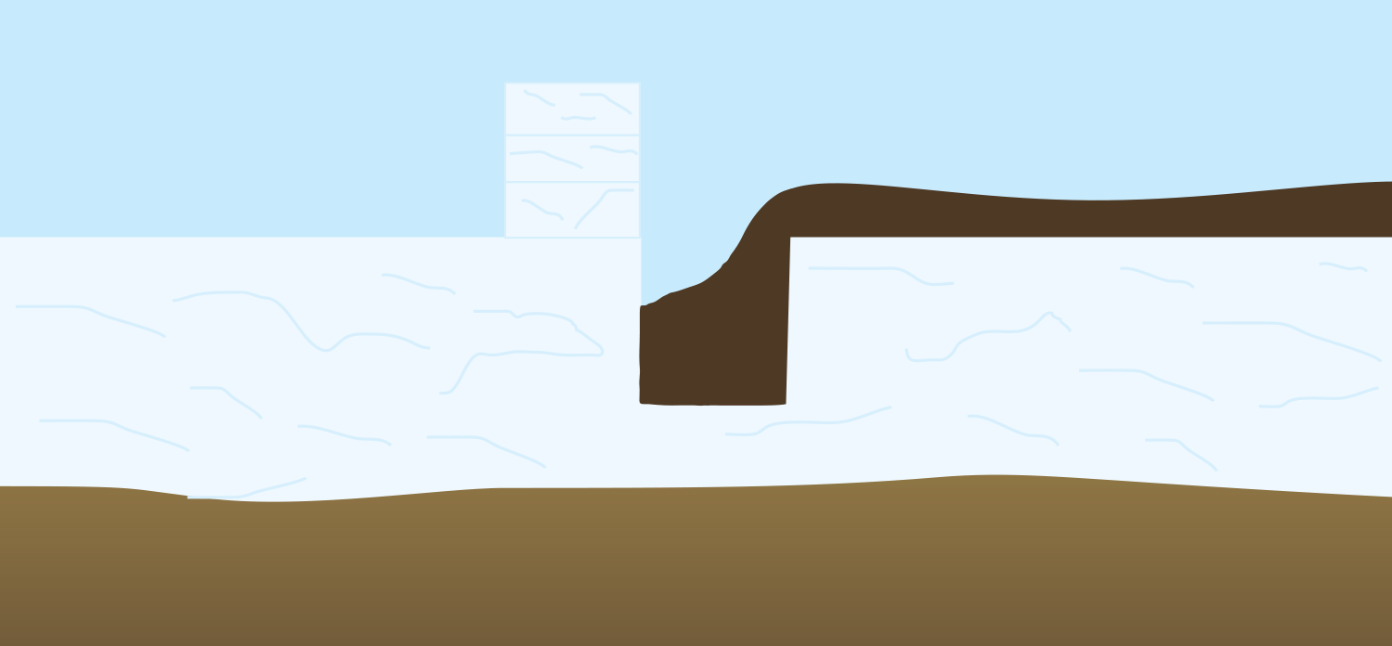
Response Strategies for Oil in Ice
Source: OSRL
Source: OSRL
CGPRT(W) : Ensuring Clean Seas and Coasts in Western Region ……

Slide 19
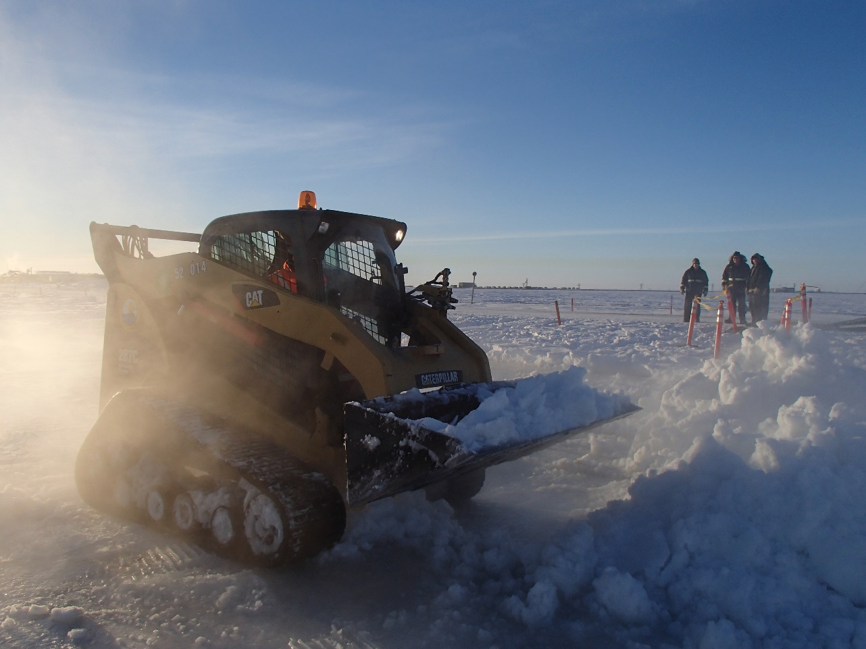
Response Strategies for Oil in Ice
Source: OSRL
CGPRT(W) : Ensuring Clean Seas and Coasts in Western Region ……

Slide 20
Response Strategies for Oil in Ice
Solid ice
Containment
  Oil below ice can be accessed by cutting trenches, slots or holes using chain saws or augers − recover with skimmers to portable storage
  It can be difficult to know where the oil is
  Can cut holes downstream of spill to intercept in a river spill below ice
Recovery
  Using skimmers or vacuum systems – limitations due to ice clogging pumps or equipment freezing
CGPRT(W) : Ensuring Clean Seas and Coasts in Western Region ……

Slide 21

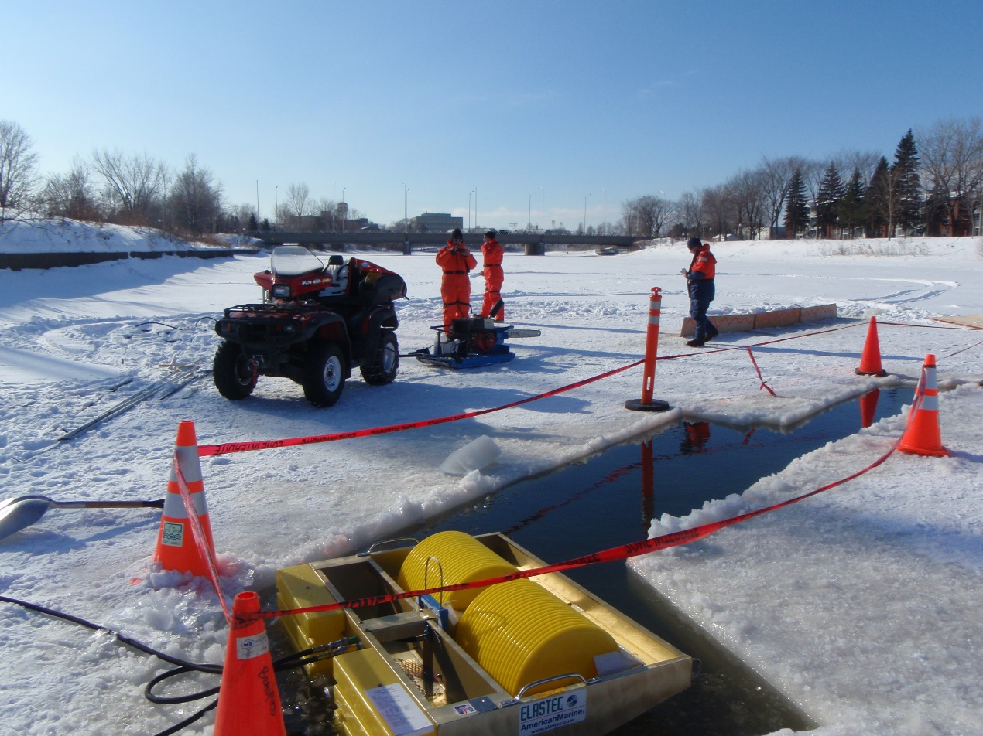
Response Strategies for Oil in Ice
CGPRT(W) : Ensuring Clean Seas and Coasts in Western Region ……

Slide 22
Response Strategies for Oil in Ice
Solid ice
Dispersants
  Not effective on solid ice
Burning
  Can be effective if done while oil is fresh – this window is longer if oil has been trapped below ice
  Can achieve an oil thickness of at least 2 to 3 mm – can build berms to contain
  Trench the oil because the burn will generate melt water
CGPRT(W) : Ensuring Clean Seas and Coasts in Western Region ……

Slide 23
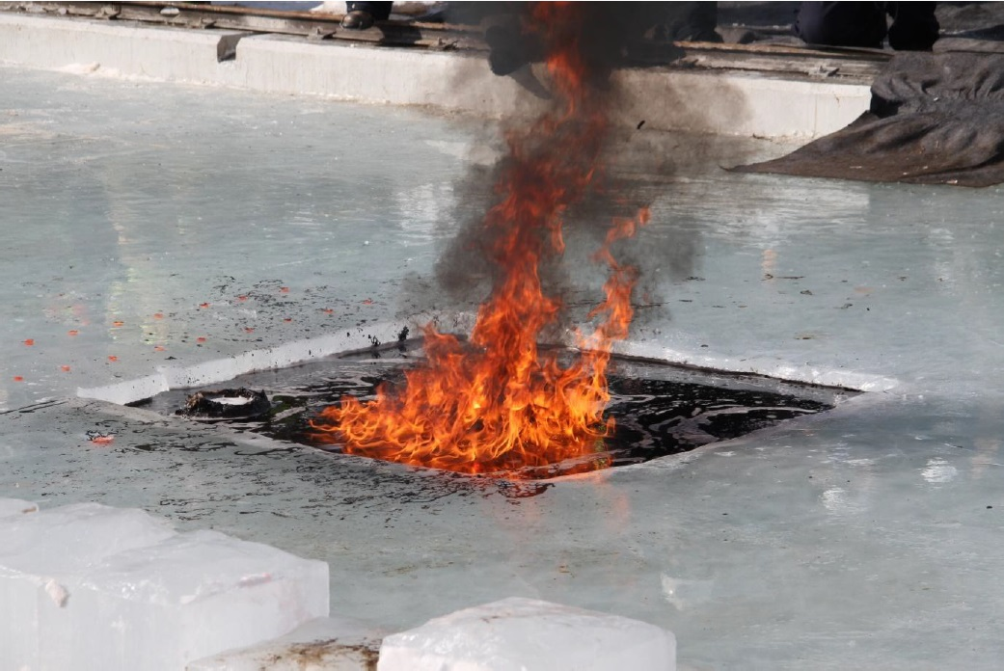
Response Strategies for Oil in Ice
Source: OSRL
CGPRT(W) : Ensuring Clean Seas and Coasts in Western Region ……

Slide 24
Response Strategies for Oil in Ice
Broken ice
Containment/Diversion/Deflection
  Depending on ice concentration and type of ice, e.g. slush, pancake ice, large ice flows − booming may or may not be feasible
  If boom can be used, it must be very durable
  Boom monitoring must be done continuously as shifting ice can damage or submerge boom
Recovery
  Using skimmers or vacuum systems – may have to be moved often as leads in ice change − limitations due to ice clogging pumps or equipment freezing
CGPRT(W) : Ensuring Clean Seas and Coasts in Western Region ……

Slide 25
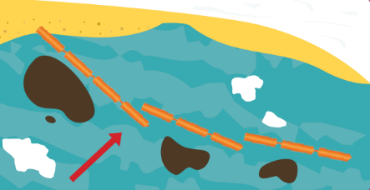
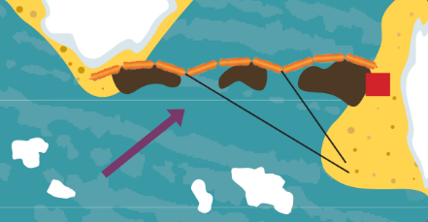
Response Strategies for Oil in Ice
Source: OSRL
Source: OSRL
CGPRT(W) : Ensuring Clean Seas and Coasts in Western Region ……

Slide 26
Response Strategies for Oil in Ice
Broken Ice
Dispersants
  Not generally effective in broken ice unless there is very low concentration of ice
Burning
  Can be effective if done while oil is fresh
  Requires an oil thickness of at least 2 to 3 mm
  Herders may be used instead of booms to thicken oil
  Fire resistant boom used to contain slick
  Waves less than 2m
  Try to burn oil in leads or at edges of ice
CGPRT(W) : Ensuring Clean Seas and Coasts in Western Region ……

Slide 27
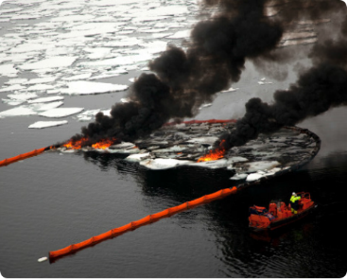
Response Strategies for Oil in Ice
Source: OSRL
CGPRT(W) : Ensuring Clean Seas and Coasts in Western Region ……

Slide 28
Response Strategies for Oil in Ice
Ice along shorelines
Ice may create a barrier and prevent oil from reaching the shoreline or oil may also penetrate the ice through cracks or between flows that have washed ashore
Ice cracks can develop in this zone due to tides or other water level changes and are a safety issue for response personnel
Shoreline response strategies will depend on shoreline type, ice concentration and ice type
CGPRT(W) : Ensuring Clean Seas and Coasts in Western Region ……

Slide 29
Response Strategies for Oil in Ice
Ice along shorelines
Containment
  On top of ice, oil can be contained, diverted or deflected by building berms with snow and ice using manual tools, i.e. shovels or mechanical tools such as graders (provided bearing capacity is sufficient)
Recovery
  Using skimmers or vacuum systems – limitations due to ice clogging pumps or equipment freezing
CGPRT(W) : Ensuring Clean Seas and Coasts in Western Region ……

Slide 30
Response Strategies for Oil in Ice
Ice along shorelines
Natural recovery – only recommended for lighter oils and exposed coasts
Washing – flooding, low pressure washing, high pressure washing may be an option if temperatures do not prevent equipment from freezing – oil must be contained and collected
Manual/mechanical removal – may require removal of an oil/snow or oil/ice combination depending on how mixed
CGPRT(W) : Ensuring Clean Seas and Coasts in Western Region ……

Slide 31
Response Strategies for Oil in Ice
Ice along shorelines
Burning
  Can be effective if done while oil is fresh – this window is longer if oil has been trapped below ice
  Can achieve an oil thickness of at least 2 to 3 mm – can build berms to contain
  Trench the oil because the burn will generate melt water
  Requires regulatory approval
CGPRT(W) : Ensuring Clean Seas and Coasts in Western Region ……

Slide 32
Conclusion
Oil in ice presents unique challenges in spill response
Safety is the first priority and there is a need for special consideration of personnel exposed to cold temperatures and working on/adjacent to ice infested waters
Conventional spill response equipment may be less effective due to the cold and presence of ice
CGPRT(W) : Ensuring Clean Seas and Coasts in Western Region ……

Slide 33
Any questions?
CGPRT(W) : Ensuring Clean Seas and Coasts in Western Region ……

